Slide 1


Google Developer Student Club
DSA BOOTCAMP
CONDUCTED BY GDSC ICOER
PRESENTED BY NIKITA CHOUDHARI (TE COMP)

Slide 2
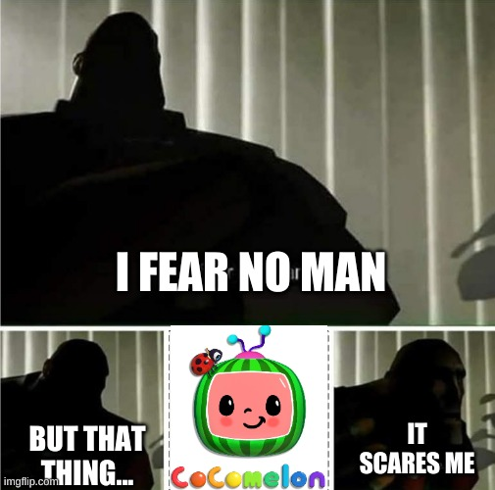
FIRST YEAR CS STUDENTS…
OBJECT- ORIENTED PROGRAMMING

Slide 3

Google Developer Student Clubs
Introduction to Object-Oriented Programming 🚀
Object-oriented programming (OOP) is a programming paradigm that organizes software design around data, or objects, rather than functions and logic.
It enables the creation of modular programs and reusable code, promoting the concept of reusability and efficiency.
OOP emphasizes concepts such as encapsulation, inheritance, and polymorphism, fostering more manageable and scalable codebases.

Slide 4

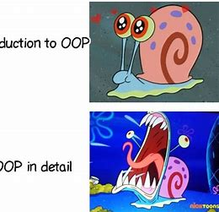
Coding Chuckles
INTRODUCTION TO OOP
OOP IN DETAIL

Slide 5
Key Concepts of Object-Oriented Programming
1
Classes & Objects
2
Inheritance
Learn how to create classes and instantiate objects to represent real-world entities and abstract ideas.
Explore the power of code reuse by implementing inheritance, allowing classes to inherit attributes and behaviors from other classes.
3
Encapsulation
4
Polymorphism
Discover how to bundle data and methods within a class, providing better organization and protecting data from external interference.
Unleash the versatility of OOP through polymorphism, enabling objects to take on different forms, & methods to take multiple behaviors based on the context of their invocation.

Slide 6

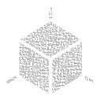

Advantages of Object-Oriented Programming
Modularity
Code Reusability
Flexibility
Encapsulated code promotes modularity, making it easier to maintain and update, enhancing code reusability and reducing errors.
Efficiently reuse code blocks across different projects, saving time and effort.
OOP allows easy modification and extension of existing code, enabling adaptability to changing requirements.

Slide 7
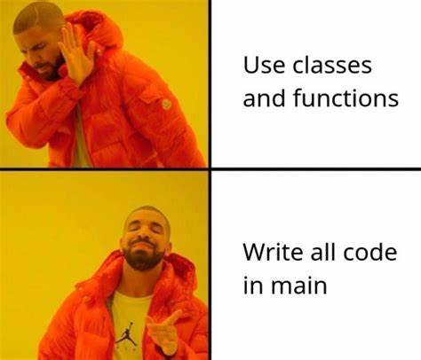
Byte Laughter

Slide 8

Object-Oriented Programming vs. Procedural Programming
1
Data & Behavior Relationship
2
Code Structure
OOP organizes code into classes and objects, while procedural programming follows a linear, step-by-step approach.
OOP focuses on grouping data and behavior together, whereas procedural programming separates them.
3
Code Reusability
OOP promotes code reusability through inheritance, whereas procedural programming requires rewriting similar code blocks.

Slide 9
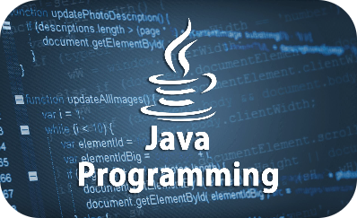
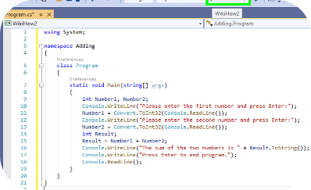
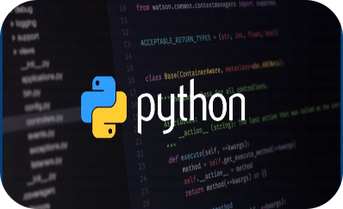
Examples of Object-Oriented Programming Languages
Java
C++
Python
An industry-standard language used for building scalable and robust applications.
Its high performance, portability, & strong support for OOP makes it a popular choice for developing complex systems and performance-critical applications.
A versatile language known for its simplicity and readability, it is used for web development, data analysis, and more.

Slide 10


What is a Class?
Class is a blueprint for creating objects, providing initial values for state (member variables or attributes) and implementations of behavior (member functions or methods).
It serves as a template or prototype from which objects are created, defining the structure and behavior that all instances of the class share.
For example, a "Car" class might contain attributes like "color" and "model" and methods like "start" and "stop" to define the properties and behaviors of all car objects.

Slide 11




What is an Object?
An object is an instance of a class that encapsulates state and behavior.
For example: A "myCar" object created from the "Car" class might have a state like "red" for color and behaviors like "start" and "stop" that operate on its internal state.

Slide 12
What is a Method?
In Object-Oriented Programming (OOP), a method is a function associated with an object that defines the behavior of the object.
Methods are used to perform specific actions or operations on the object's data.
Methods are defined within a class and operate on the attributes of that class.
They encapsulate the behavior of an object, allowing the object to perform certain actions or tasks.

Slide 13

Exercise
Create a simple "Rectangle" class and performing basic operations on it:
Attributes: length, width
Methods: area()
Implement the area() method to calculate and return the area of the rectangle (length * width).
Create an object of the Rectangle class.
Set the length and width attributes of the Rectangle object.
Print the area of the rectangle using the defined methods.

Slide 14
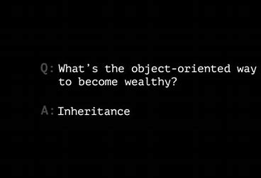

Slide 15



Inheritance
Inheritance is a fundamental concept in object-oriented programming. It allows classes to inherit properties and methods from other classes.
Think of it as building on the foundation of existing classes to create more specialized ones. Check out the flowchart below to visualize how inheritance works.
Features:
Code Reusability
Hierarchical Structure
Polymorphic Behavior
Promotion of Abstraction

Slide 16
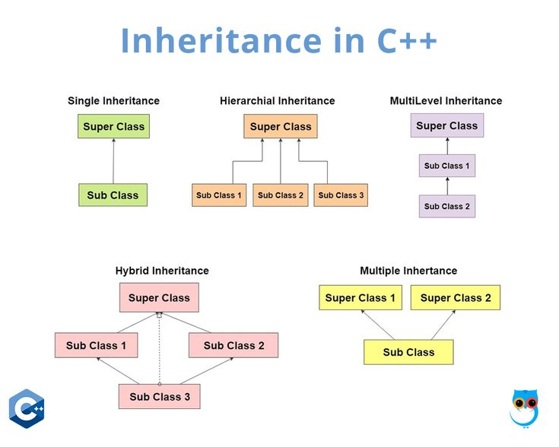
TYPES OF INHERITANCE

Slide 17

Exercise
Create a base class called Animal with a method speak() that prints "The animal speaks."
Then create two derived classes, Dog and Cat. Override the speak() method in both derived classes to print "The dog barks" for the Dog class and "The cat meows" for the Cat class.
For extra practice, create instances of the Dog and Cat classes and call their speak() methods to observe the output.

Slide 18



Encapsulation
Encapsulation is the process of bundling data and the methods that operate on that data together as a single unit. I
It allows for data hiding, ensuring that the internal workings of an object are not exposed to outside code.
Encapsulation promotes code organization, modularity, and reusability.

Slide 19
Project Manager: Cindy, please write a function to return woman age.
Cindy: Piece of cake!
public class Woman { private int age = 50; // attribute not visible outside of an object public int getAge() { // control access to the object's attribute return 30; } }

Slide 20

Exercise
Problem Statement:
Create a simple Bank Account program using classes and objects.
The program should allow users to perform basic banking operations such as deposit, withdrawal, and check balance.
Requirements:
The Bank Account class should have attributes like account number, account holder name, and balance.
Implement methods for depositing and withdrawing money from the account.
Create a method to check and display the current balance.
Create an object of the Bank Account class and perform some operations like depositing money, withdrawing money, and checking the balance.

Slide 21
CONCLUSION
Object-oriented programming provides a powerful paradigm for building complex and scalable software. Embrace OOP's key concepts, benefits, and best practices to unlock your development potential.🚀
In conclusion, OOP encourages modular design, inheritance, encapsulation, and code reusability, fostering efficient and adaptable software development.

Slide 22

Thank You!
Thank you for your attention and for joining us on this journey through the world of object-oriented programming.

